Slide 1
Number of Patients Over Quarters
Data Extracted: Sep 21, 2023

Slide 2
Number of Patients Over Quarters
Quarter | Number of Patients
2023-Q1 | 10
2023-Q2 | 20
2023-Q3 | 30
2023-Q4 | 40

Slide 3
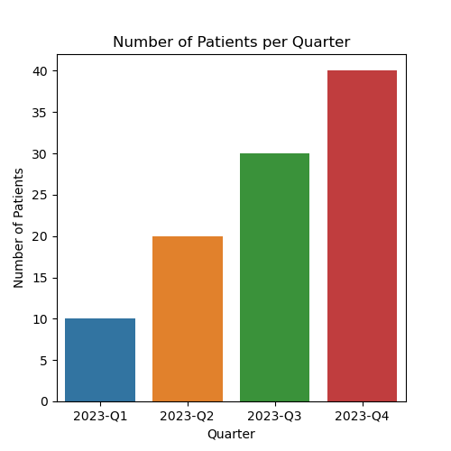
Bar Plot

